Slide 1
Web Services And Web API

Slide 2
WEB Service asp.net
A web service is a web-based functionality accessed using the HTTP protocols of the web to be used by the web applications.
By using Web services, your application can publish its function to the rest of the world
Web services can be used by other applications (e.g Web services your accounting department's Windows servers can connect with your IT supplier's UNIX server).

Slide 3
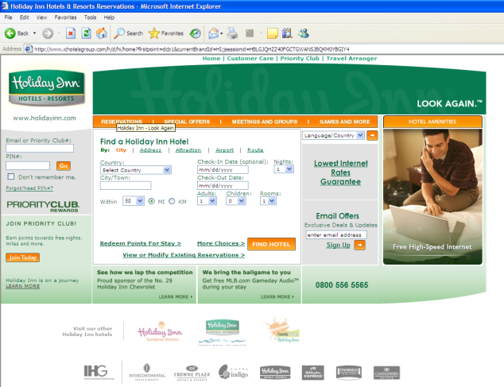
Service Composition
Hotel
Reservation System
Application Servers
API
2
1
4
3
Flight
Reservation System
Holiday Reservation Service Front End
API
Service Composition
Web service can be used to:
Information providers: weather, news, flight information

Slide 4
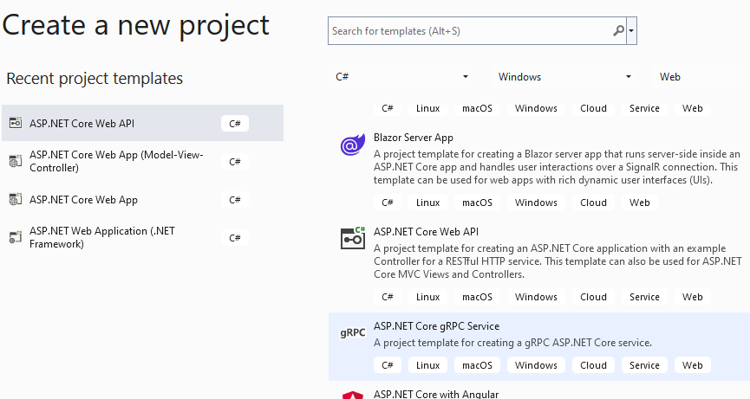
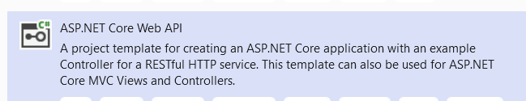
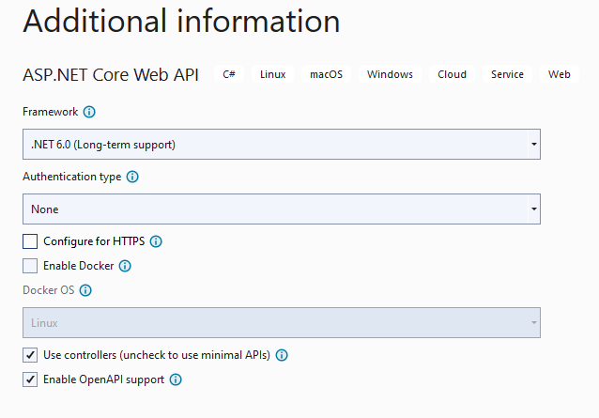
Visual Studio 2022
How to create an Asp.Net core web API?

Slide 5
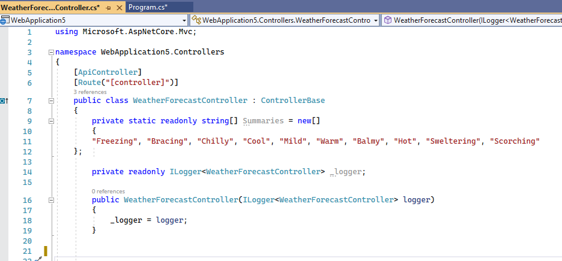
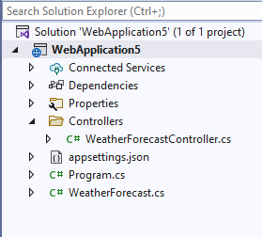
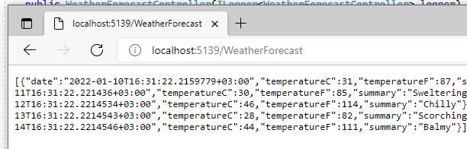
Your code

Slide 6

you need to Enable CORS (Cross Origin Resource Sharing)
To allow remote client communication
Add all red code to the Program file

Slide 7
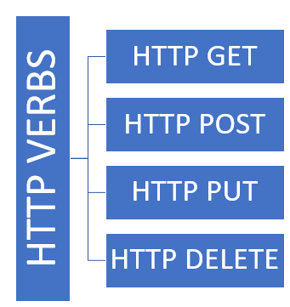
RESTful Web API. Web API is mostly used for CRED (Create, Read, EDIT, DELETE) operations.
Front End
Back End
Browser
Read Operation
Fetch
Sql Database Server
Create Operation
Mobile
Response
Update Operation
Devices
Delete Operation

Slide 8
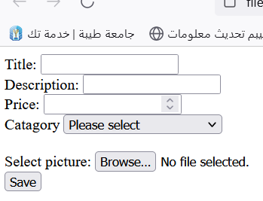

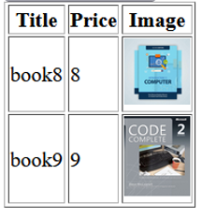
State in Web Applications via API
Staying at the same page
View
API Controller
fetch(StoreItem Url,Data)
Data
Data
DB
Response(“successes message”)
StoreItem
fetch(getItems Url)
getItems
Response.Data(JSON Arrau)
Data

Slide 9
REST API Sending Data Types
http://localhost
Client
HTML Page
JavaScript
Body – JSON object
Server
.Net API
Controller
Body – FormData-(image)
Query string - ?id
Parameter - /id

Slide 10
Sending data using REST API Methods Examples
JavaScript API Fetching Methods examples
GET Single Record
fetch("http://localhost:5113/Test/Id")
http://localhost
fetch("http://localhost:5113/Test")
Server
.Net API
Controller
Client
HTML Page
JavaScript
GET LIST of Records
POST
fetch("http://localhost:5092/ Test",option)
JSON Object
fetch("http://localhost:5092/ Test?Id ",option)
PUT
DELETE
fetch("http://localhost:5092/ Test?Id ",option)

Slide 11
Java script Fetch Example
options = {
method: ‘xx',
headers: {
'Content-Type': 'application/json'
},
body: JSON.stringify(xx)
or body: xx
}
fetch("http://localhost:5092/......",options)
Post/Put/Delete
JSON Object/List of Objects
formData (image)

Slide 12
.Net server API methods Examples
http://localhost
Test API Controller
GET Single Record
query string
fetch("http://localhost:5092/Test?”+Id)
Server
API
Controller
[HttpGet]
public Get(int id)
GET Single Record
parameter
fetch("http://localhost:5092/Test/”+Id)
[HttpGet("{id}")]
public Get(int id)
fetch("http://localhost:5092/Test")
[HttpGet]
public Get()
GET LIST of Records
default
GET LIST of Records
Using verb
fetch("http://localhost:5092/Test/PepoleList")
[HttpGet(“PeopleList”)]
public PeopleList ()
POST json
fetch("http://localhost:5092/ Test",option)
[HttpPost]
public Post([FromBody])
POST image
fetch("http://localhost:5092/ Test",option)
[HttpPost]
public Post([FromForm])
fetch("http://localhost:5092/ Test/”+Id) ,option)
[HttpPut("{id}")]
public Put(int id, [FromBody])
PUT json
DELETE
fetch("http://localhost:5092/ Test/”+Id) ",option)
[HttpDelete("{id}")]
public Delete(int id)

Slide 13
Response: Receiving data Examples
http://localhost
API Controller
er
public IEnumerable<class> Get()
{List<class> objlst = new List<class>();
……
return objlst
Client
HTML Page
JSON Array
GET LIST of Records
await response.json();
JSON
public class Get(int id)
{class obj = new class();;
……
return (obj)
await response.text();
GET Single Record
String
public string Post(
……….
return (“successfull”)
POST
PUT
DELETE

Slide 14
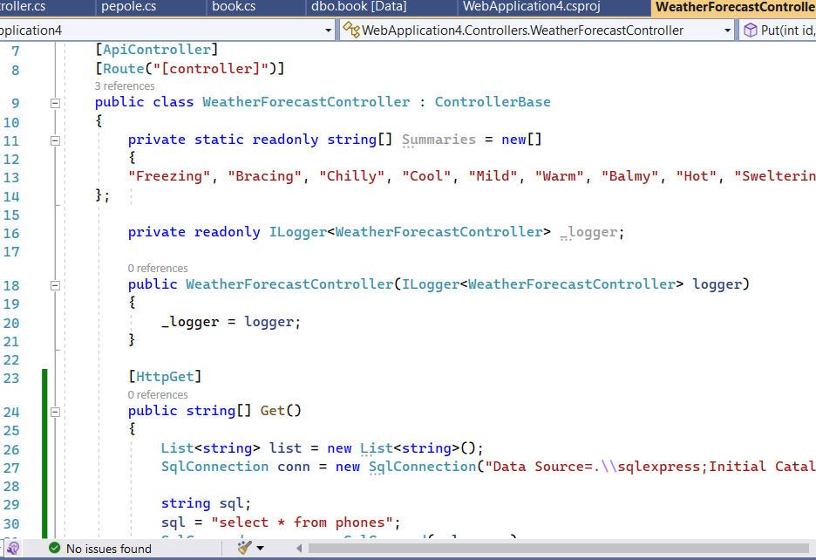
You can Add your Api code here in this section

Slide 15
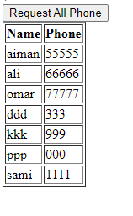
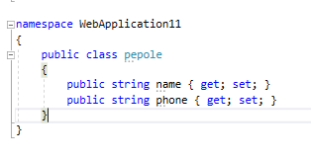

Example 1 create a Get Method to get all phone records using list of objects
-create people class
Server Side
Input:?
Client Side
Parameter | ?
Option | ?
Body | ?
Method :?
sql = "select * from phones";
output :?

Slide 16
Server Side
Client Side
Parameter | No
Option | No
Body | No
Input: none
[HttpGet]
sql = "select * from phones";
output: list of JSON object

Slide 17
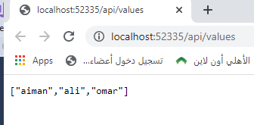
WeatherForecast
Create this html page
Make sure to copy the
port number from your application

Slide 18
4-Create Api code Code at the WeatherForcast Controller
Note that since API will return string or JSON object,so don’t return the IActionResult

Slide 19
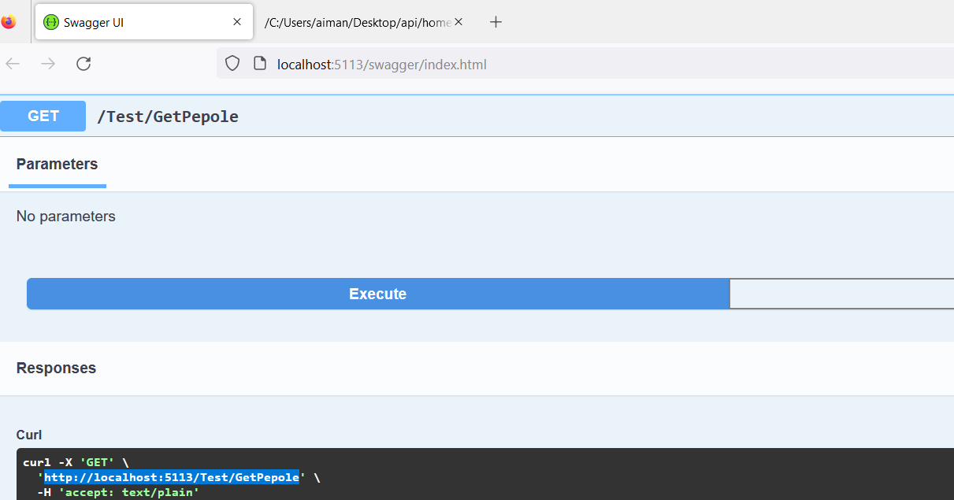

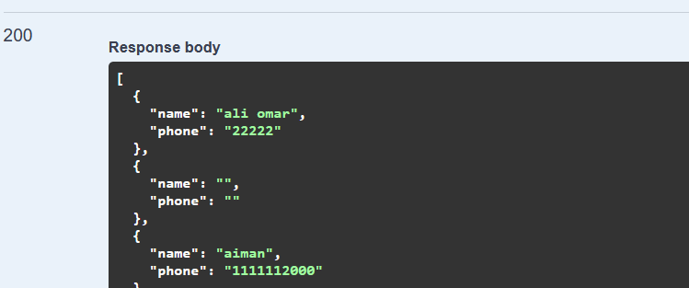
Debuging API (not easy)
1- you can use the Swagger tool to test the API within VS Studio
result

Slide 20
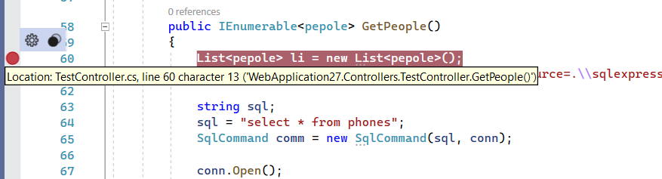
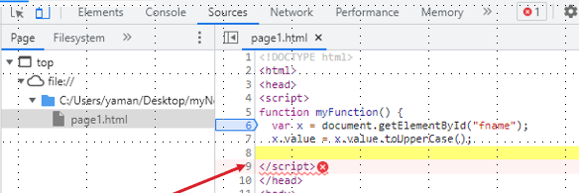
2- If swagger is working fine then the server side code is correct 2- then run the client file
3- if the client is not working then insert a breakpoint
3- If the program reach this breakpoint it means the javascript fetch is working fine and it is calling the API correctly
4-then Step into first line to check if the values received from the client are correct or not
5- if the program did not reach the break point then there is error in javascript code (use the inspect and debugger to find the error)

Slide 21

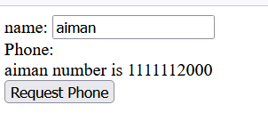
Example 2 Using Get Method to get a single phone record
Client Side
Parameter | ?
Option | ?
Body | ?
Server Side
Input:?
API
?
sql = "SELECT * FROM phones where username ='" + name + "' ";
output: ?

Slide 22
Example 2 Using Get/parameter Method to get a single phone record
Server Side
Client Side
Parameter | name
Option | No
Body | No
Input: name parameter
API
[HttpGet("{name}")]
sql = "SELECT * FROM phones where username ='" + name + "' ";
output: JSON object

Slide 25

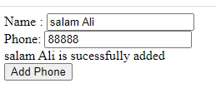
Example 3 Using POST Method to Insert a phone record
Server Side
Client Side
Parameter | ?
Option | ?
Body | ?
Input: :?
API
Method :?
insert into phones (username,userphone) values ('" + nn + "','" + pp + "' )";
output: :?

Slide 26
Example 3 Using POST Method to Insert a phone record
Input: JSON object(name, phone)
Client Side
Parameter | no
Option | POST
Body | JSON(name, phone)
API
[HttpPOST]
insert into phones (username,userphone) values ('" + nn + "','" + pp + "' )";
output: string successful message

Slide 27
Shortcut for mapping form fields to people object
To receive JSON object from the form

Slide 28
Sweet alert to show A basic message show for a limited time (Toast)
For more examples at https://sweetalert2.github.io/

Slide 29

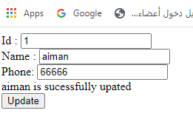
Example 4 Using PUT Method to Update a phone record
Client Side
Parameter | ?
Option | ?
Body | ?
Server Side
Input: :?
API
Method :?
update phones set userphone = '" + pa + "', username = '" + na + "' where id = '" + id + "'
output: :?

Slide 30
Example 4 Using PUT Method to Update a phone record
Client Side
Parameter | Id
Option | PUT
Body | JSON(name, phone)
Server Side
Input: JSON object(name, phone) + Id parameter
API
[HttpPut("{id}")]
update phones set userphone = '" + pa + "', username = '" + na + "' where id = '" + id + "'
output: string successful message

Slide 33
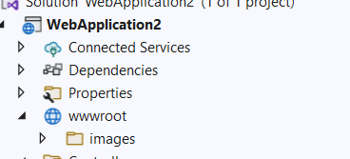
Example 4: Complex Data Communication including Image
Using POST Method to Insert a Book record with image
1-Create Images and wwwroot folder

Slide 34
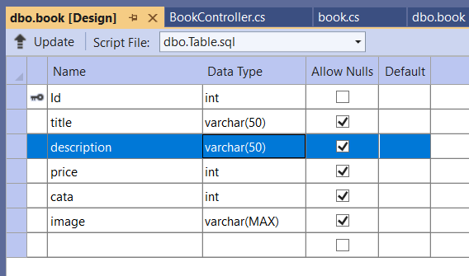
2-Create book table
CREATE TABLE [dbo].[book]
(
[Id] INT NOT NULL PRIMARY KEY IDENTITY,
[title] VARCHAR(50) NULL,
[description] VARCHAR(50) NULL,
[price] INT NULL,
[cata] INT NULL,
[image] VARCHAR(MAX) NULL
)
public class book
{
public int Id { get; set; }
public string title { get; set; }
public string description { get; set; }
public int price { get; set; }
public int cata { get; set; }
public string image { get; set; }
}
3-add the book class

Slide 35
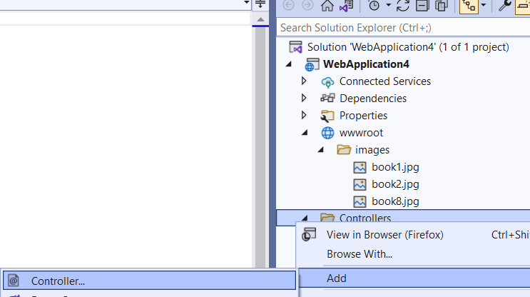
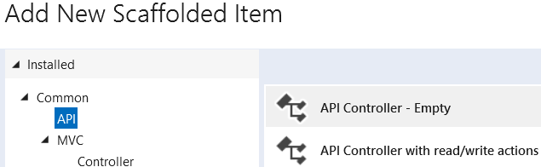
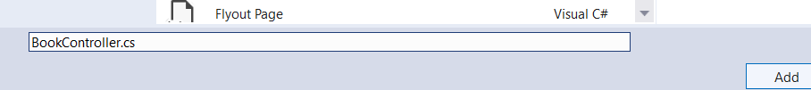
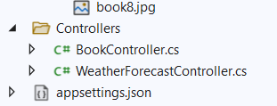
4-Add new Book Controller
5-Add the Post Code at the Book Controller

Slide 36
You can Remove api/Book from the controller path
Local host IP

Slide 37
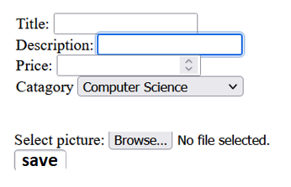
6-Add this code to the html code file

Slide 38
Using FormData appending to send file data to the action

Slide 40
Using Get Method to get all books

Slide 41
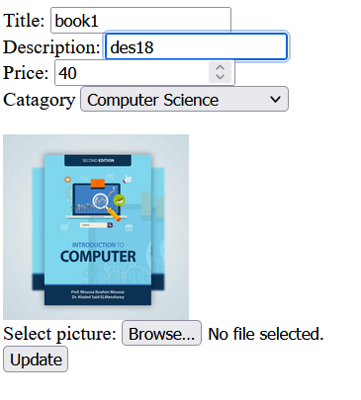
Search

